Slide 1


FasTrac Fun: Webcams, Sensors, and Instant Messaging
Daryl Herzmann
Iowa State University
John McLaughlin
KCCI-TV Des Moines

Slide 2
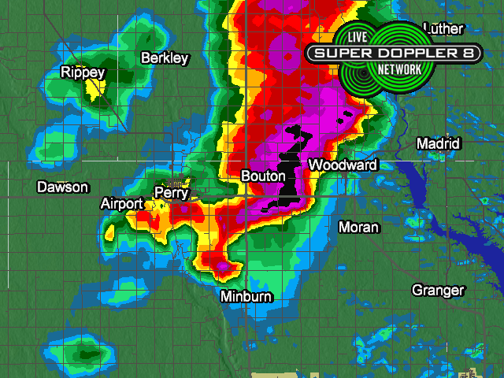
Boring!!! ☺

Slide 3
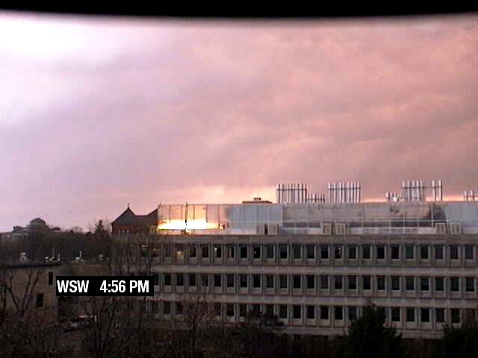
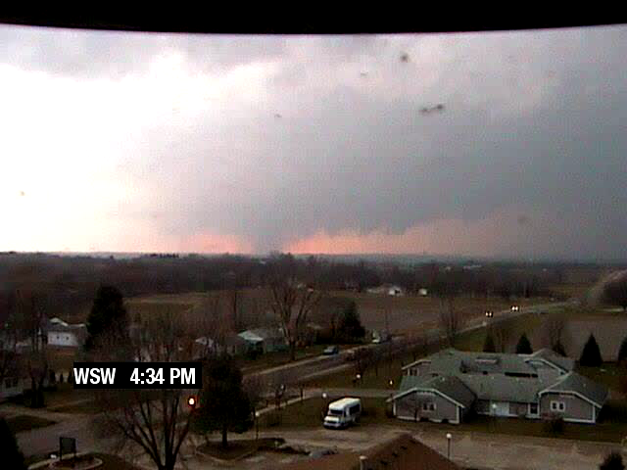
Not boring!!
KCCI’s network of web cameras captures 2.5 tornadoes live on “Cyclone Saturday” (12 Nov 2005)

Slide 4
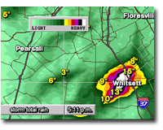
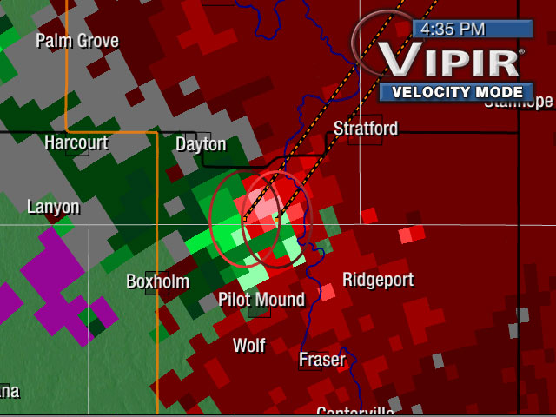
Baron Algorithms,
Not Boring!!!, hi Dr Greg!

Slide 5
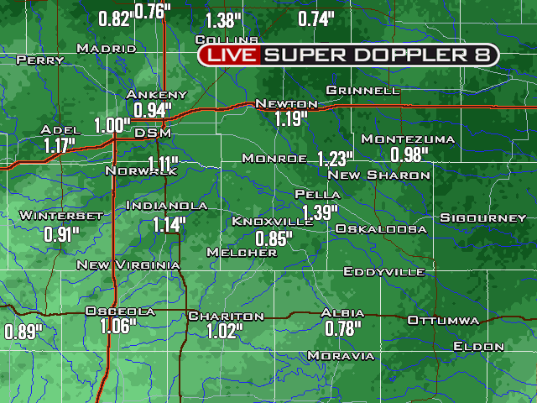
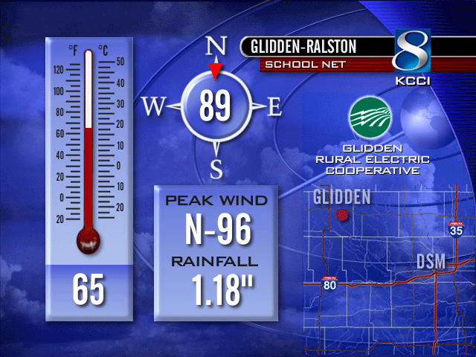
Live Ground Truth!
Live School sensors compliment baron hydro products and RADAR wind estimates

Slide 6
Boring and slow!!!
THE NATIONAL WEATHER SERVICE IN DES MOINES HAS ISSUED A
* TORNADO WARNING FOR... UNION COUNTY IN SOUTH CENTRAL IOWA.
* UNTIL 630 PM CST.
* AT 557 PM CST...NATIONAL WEATHER SERVICE DOPPLER RADAR WAS TRACKING A SEVERE THUNDERSTORM WITH A CONFIRMED TORNADO NEAR CRESTON...OR 49 MILES SOUTHWEST OF DES MOINES. THE STORM WAS MOVING NORTHEAST AT 40 MPH.

Slide 7
Live and concise
Taken from Instant Messaging logs:
  (5:59 PM) Nwsdmx3: TOR warning coming for Union till 6:30
  (6:01 PM) Iembot: DMX issues Tornado Warning for Union [IA] till 6:30 PM CST
  (6:02 PM) Iembot: 3 W Creston [Union Co, IA] amateur radio reports TORNADO at 05:57 PM CST --

Slide 8
All of these tools and more are available in FasTrac!!!
Web Cameras (Canon VB-C10 VB-C50i)
Live Sensors
Instant Messaging (Baron SpotterNet & IEM Chat)
Go on, play with your FasTrac,
I’m gonna keep talking….

Slide 9
Webcam stuff
Live images for the internet.
Lapses for on-air / internet
Guiding the cameras (auto tracking)
System monitoring
Archiving
Other tricks and treats

Slide 10
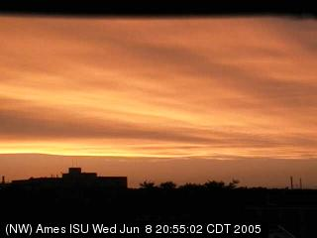
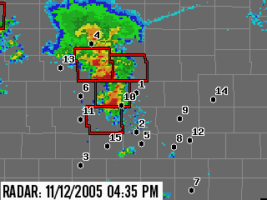
1. Live images for internet
Routinely poll webcams and upload still image to website
Display timestamp, location, and camera direction on every image!
Overview display with camera locations, NEXRAD, and NWS warnings

Slide 11
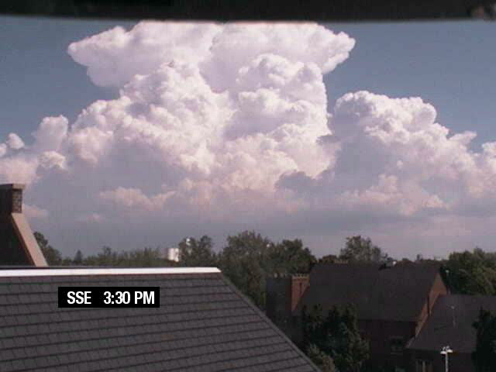
2. Onair / online lapses
Automated generation of daily webcam lapses
Copies sent online for public perusal
Instant message sent when lapses have been delivered to studio

Slide 12
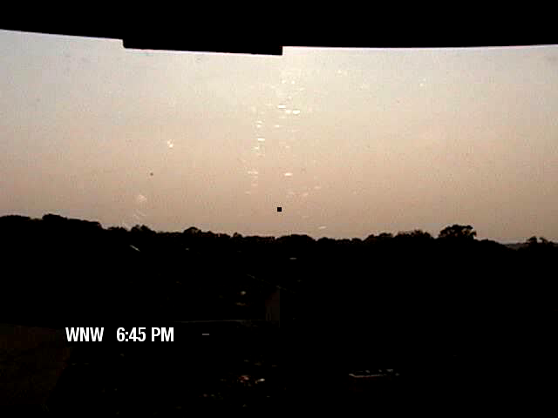
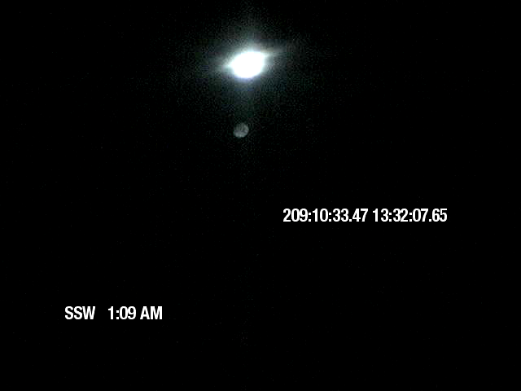
3. Guiding the cameras

Slide 13
4. System Monitoring
Automated email sent to site contacts if the camera stops responding to the internet
Meta data tracking

Slide 14
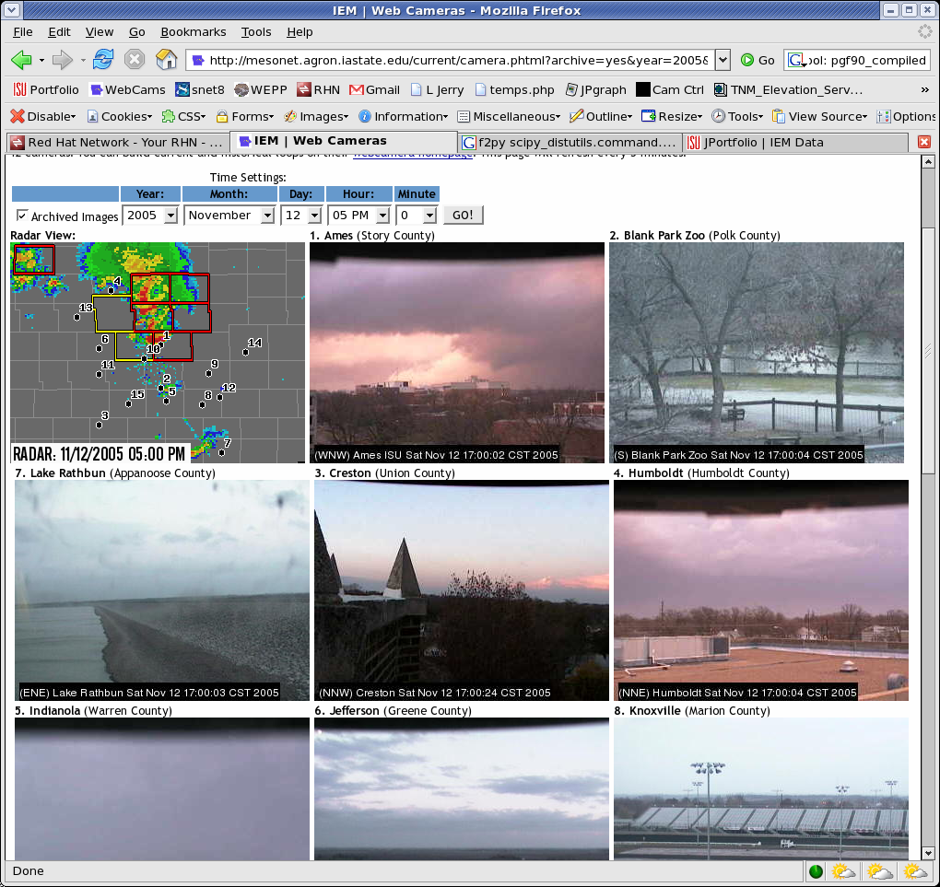
5. Archiving
5 minute interval archive since the beginning (2003)
Generate custom lapses from the archive
1 minute archive during severe weather

Slide 15
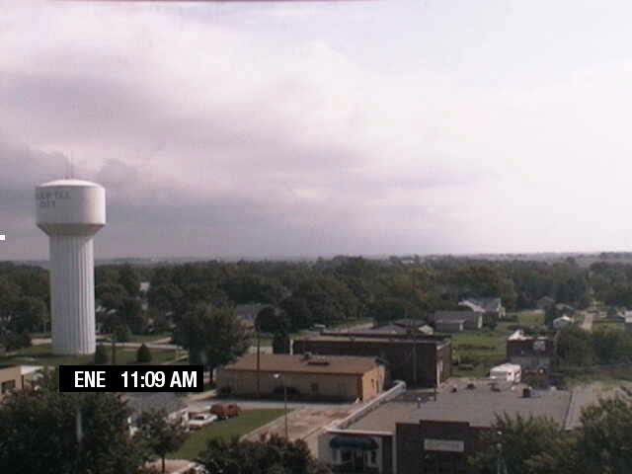
6. Other Tricks
NEXRAD attribute tracking
Step #1. Have storm near camera.
Simple concept, track NEXRAD attribute and projected path with web camera
Perhaps cooler than it is usable
Lame example to the right ☺ KDMX “D0” 22 Aug 2006

Slide 16
Sensors Stuff
Website presence
Archiving
System Maintenance
Routing to NWS

Slide 17
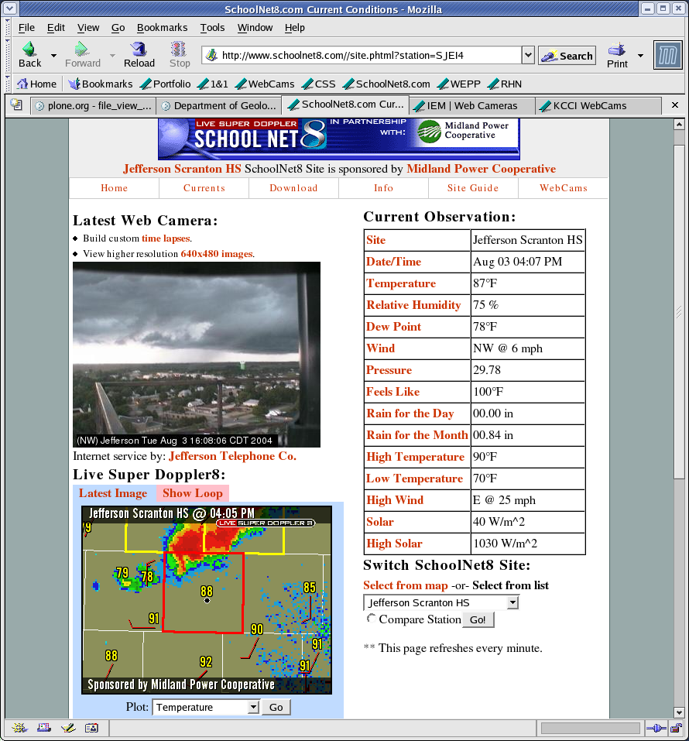
Website
Fancy pants website combining webcam, live doppler, warnings, and sensors.

Slide 18
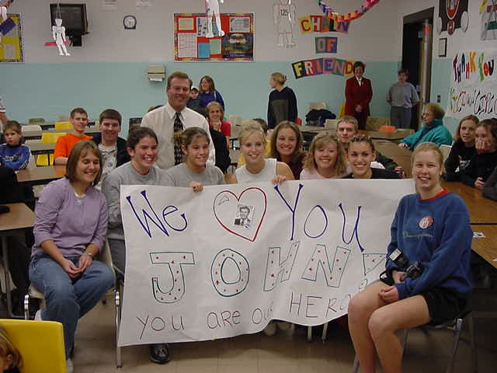
“Educational” too!

Slide 19
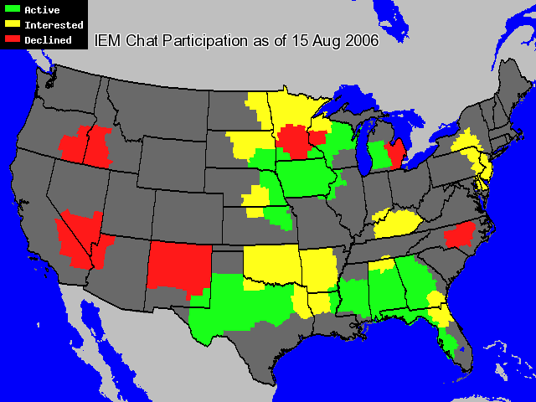
Instant Messaging Stuff
(don’t spoil Nate’s talk, 4 PM Sat)
https://iemchat.com
All media are free to join even without local NWS included

Slide 20

Blah blah blah… done!
Daryl Herzmann
akrherz@iastate.edu
515.294.5978

